Slide 1



Please delete this slide before sharing with clients
How to use
Share directly with client after they have gone through training.
This is a one-stop shop for clients to help them become familiar with ShopperMX.
If clients have questions about how to use SMX, point them to a slide in this deck.
Delete this first slide and then save as a PDF to ensure comments aren’t seen.
Smaller versions of this deck is available on SharePoint which will ensure the slide numbers and content is relevant.
Remember to update your contact
information on slide 109
1

Slide 2


ShopperMX Handbook

Slide 3


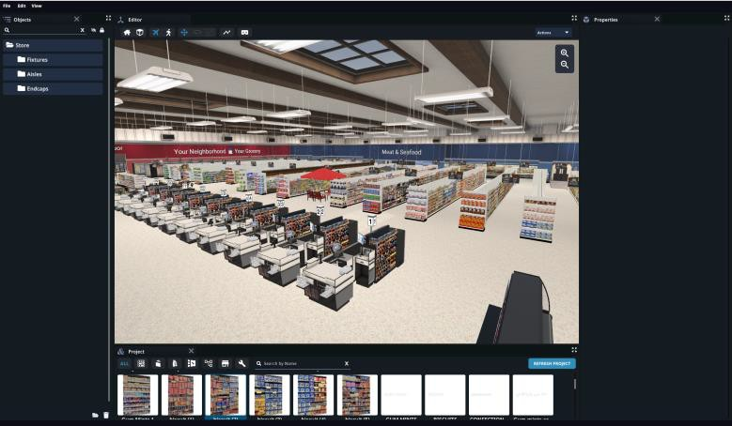


Slide 4
Contents
Pleas e cli ck on th e section yo u would l ike to be taken to
Click directly on the ‘How To’ to be taken to that slide in the handbook.
ShopperMX Support Site
Assets include stores, planograms, products, signage & displays.
PRESENTATION TOOLS
Logging in
Project Home Page Creating a New Project Managing Project Access
Importing a Planogram Manual Planogram Builds Creating a Display
Working in 3D Asset Builders Adding & Editing Shelves Adding Products to Shelves Adding Signage to POGs & Displays
Products
Planogram Image Refresh
Creating a Store Navigating a Store Adding Assets to a Store
Adding & Editing Signage in a Store
Moving Assets Rotating Assets
Switching between Asset Builders
Product Highlighting Taking Screenshots & VAA Reporting
Creating a DIY Video Tours
Pinboards
Ther e ar e mu ltiple w ays t o co mplete certain action s.
Star s s ignif y s tandar d wo rkf lows.

Slide 5
Getting Started with ShopperMX
Logging in
Project Home Page
Creating a New Project Managing Project Access

Slide 6
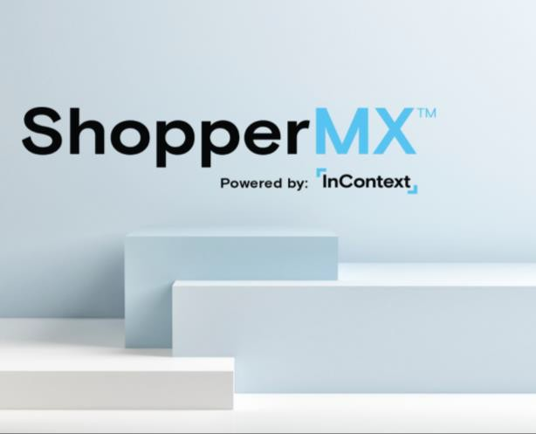
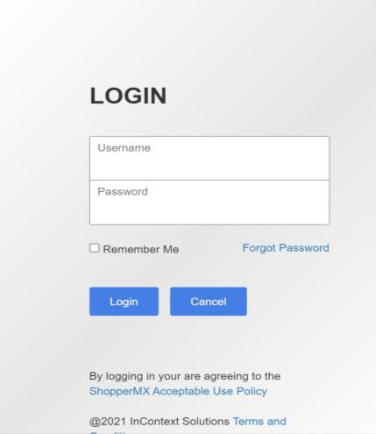
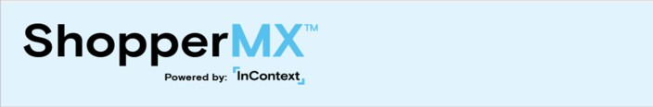
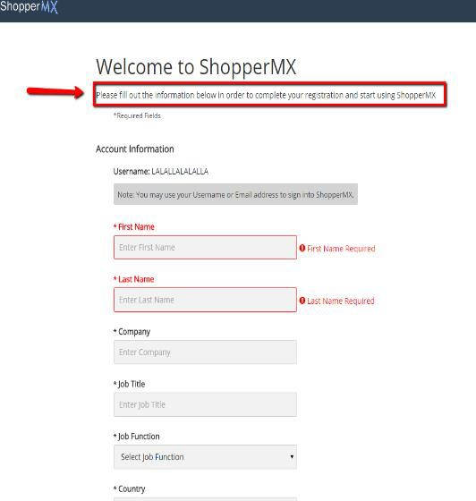
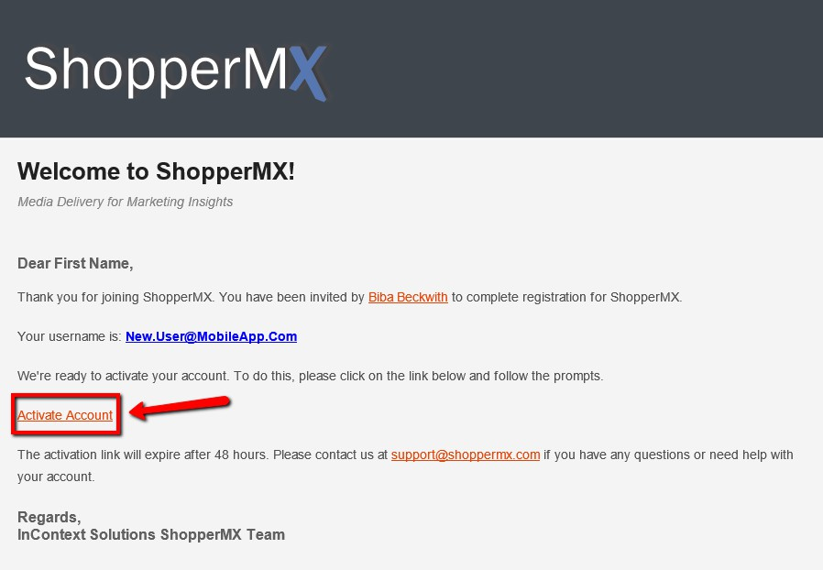
If you have an issue signing in, please reach out to your ICS representative or email support@incontextsolutions.com
Log Into your ShopperMX Account
New ShopperMX users receive a Welcome to ShopperMX e-mail. If you did not receive an e-mail, please contact support@shoppermx.com.
Click on the Activate Account link to get started.
Fill out the Account Information page. Set your password. Your username is your e-mail.
Click on the Yes, I agree to the ShopperMX Acceptable Use Policy and then click Save and Open ShopperMX.
Go to Shoppermx.com and log into your account.

Slide 7
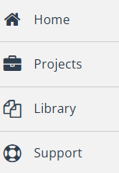

Home Screen
Home – takes you back to the main page
Project – all projects you have created or have been given access
Library – view of all assets: stores, POGs, products, signage & displays
Support – ShopperMX help page
Tip!
In addition to the support tab, for all inquiries feel free to reach out to a member of the client services team at InContext at anytime.

Slide 8
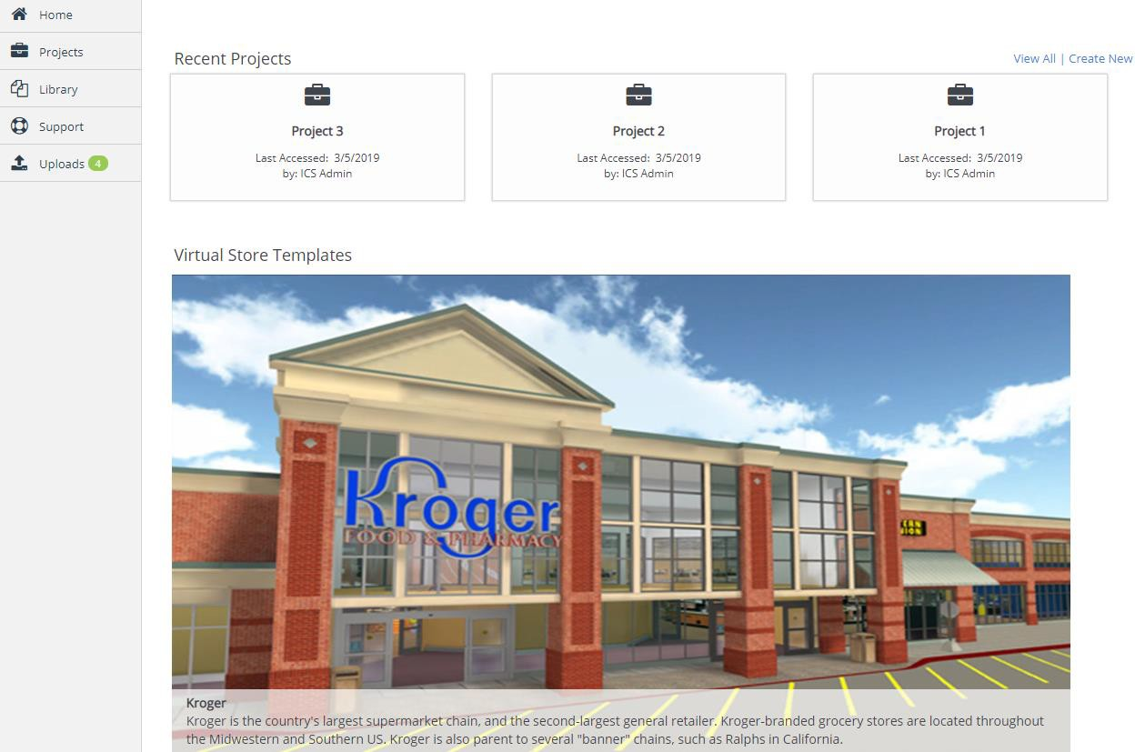
Home Screen
Recent Projects – SMX shows you the 3 most recent projects you have created or have been given access to
View All – same as project function on previous page
Create New – Create a new project
Virtual Store Templates – lists 3D stores available / licensed to you
Note!
Clicking ‘View All’ and clicking the Projects tab brings you to the same page.

Slide 9

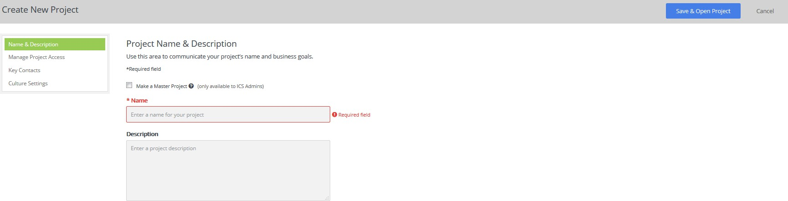
Creating a New Project
A project should be treated like a folder. It will house all the assets you create, copy or import.
From the Home or Project tab on the main page, click on Create a New Project
Fill out the project Name & Description page: project name, description (optional).
Click the Save & Open Project icon. You have successfully created a project!
Note!
You can optionally manage project access, key contacts, and culture setting from this page too. Just click the options on the left to adjust those settings.

Slide 10
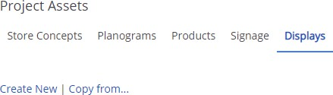
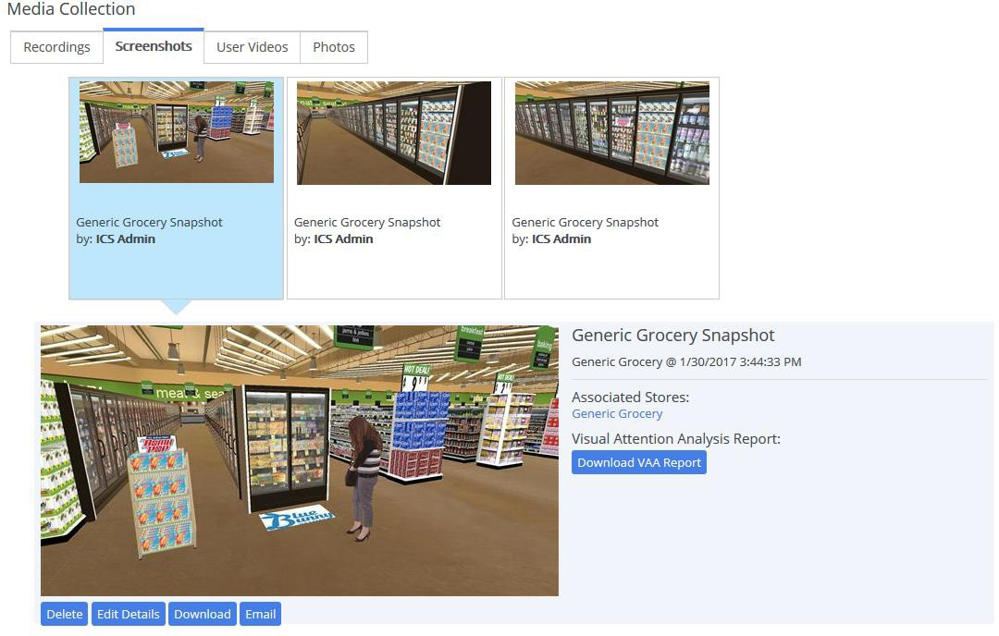


Project Assets & Media Collection
Note!
Assets (planograms, stores, products & signage are specific to a project however, you can copy these from one project to another).
Project Assets include all content used in ShopperMX:
Stores Concepts – virtual environments licensed to you
Planograms – In aisle, cooler doors, end caps
Products – Virtual product models
Signage – Create with .jpg or .png image files
Displays – Create and visualize displays from included standard or custom display templates
Media Collection: Any content captured in ShopperMX is automatically saved in the Media Collection on the project’s home page.
Recordings: Videos that have been filmed using the ShopperMX record feature. These can be downloaded or emailed directly from ShopperMX
Screenshots: Photos taken using the screenshot feature in
ShopperMX. These can be downloaded or emailed from ShopperMX, or available for Visual Attention Analysis (VAA)
User Videos: Where to find videos uploaded by you
Photos: A place to import your own photos for VAA Documents: A place to upload your pdfs or PowerPoint presentations for them to be added to a pinboard

Slide 11
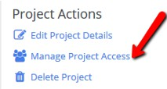

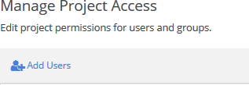
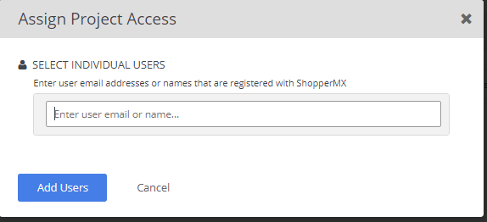
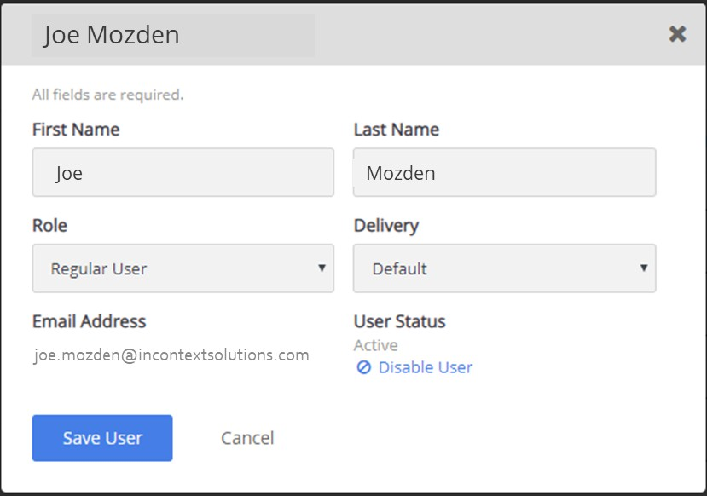
Managing Project Access
By default, project access is restricted to only the user who creates the project. To enable access for other users within your organization, navigate to the Project Actions area of your project’s home page.
To give other users access to your project, follow these steps:
Step 1 - Select the Manage Project Access button under ‘Project Actions’
Step 2 – Select Add Users button
Step 3 – Type in email or name of SMX user you’d like to provide access to then
click Add Users
Step 4 – Once added new user, select name of individual to edit access level: Regular User: Full access to create and edit all assets
View Only: Restricted to only view existing assets
Project Admin: Full access to create and edit all assets and project access
Step 5 - Select Save User Access or Cancel to save or discard your changes, respectively.

Slide 12
Creating & Importing Content
Importing a Planogram Manual Planogram Builds Creating a Display
Working in 3D Asset Builders Adding & Editing Shelves
Adding Products to Shelves
Adding Signage to POGs & Displays Products
Refresh Planograms

Slide 13
Importing a Planogram
Using .PSA files (only accepted POG format)

Slide 14
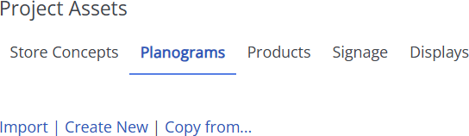
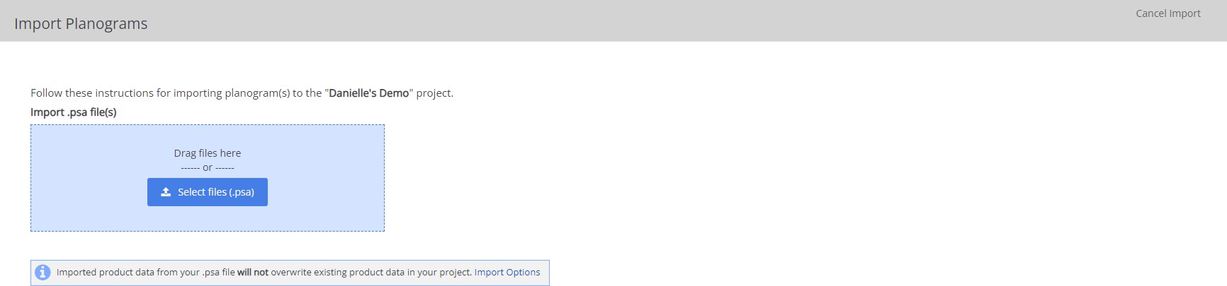
Importing a Planogram
Under Project Assets, select the Planograms tab
Select, Import
On the next screen drag and drop the .PSA file into the blue box or click Select Files(.psa)
You can upload multiple files at once!
.PSA files are the only file types accepted.

Slide 15
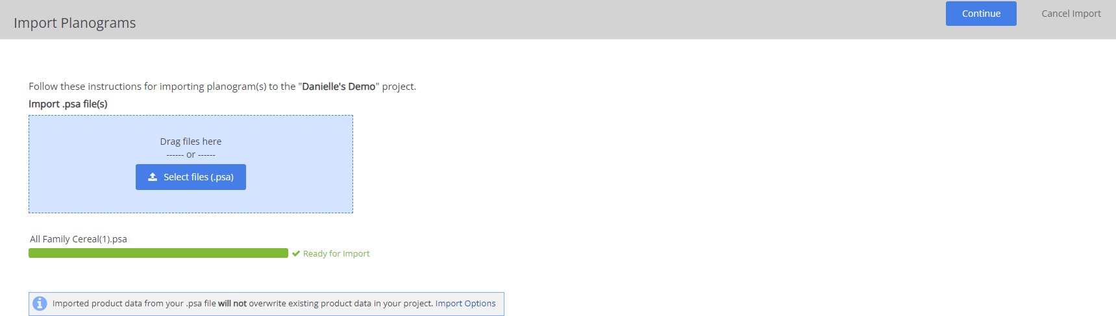
Importing a Planogram
Once the loading bar turns green, a check mark will appear that says Ready for Import.
To maintain current product data or overwrite existing product data with the .PSA info, click Import options.
Select Continue at the top right of the screen.
To cancel the import, you can select Cancel Import, at the top right, at any time.

Slide 16
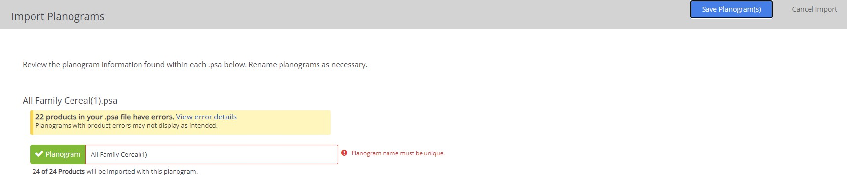
Importing a Planogram
The next screen will flag errors with the planogram or prompt you to match products/quick match (if applicable) to products in your global library.
You can select view errors to see the error codes
All planograms must have a unique name. Update the planogram name if prompted by clicking into the box
See the What is Quickmatch and how does it work? article
When you are ready, select Save Planogram(s) at the top right of the screen.

Slide 17
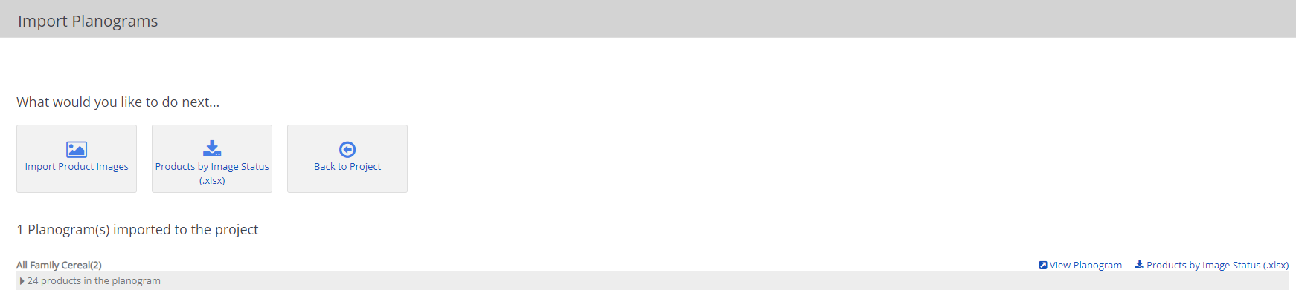
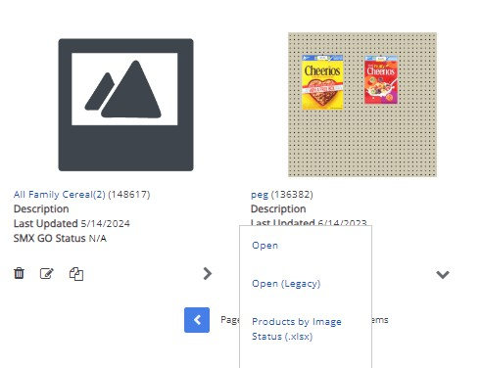
Importing a Planogram
The next screen will confirm that the Planogram has been imported.
You have the option to Import Product Images, Download Products by Image Status, or go Back to Project.
Back on project page > Project Assets >
Planograms
Click on the name of the planogram to open the
Planogram builder.
Or, use the dropdown menu under the thumbnail, select Open.

Slide 18
.PSA Fields Currently Supported by ShopperMX
On Planogram:
Name
Size
On Shelves:
Type
Position
Size
Peghook Spacing
On Layouts (Products on Shelf):
Position
Facings
Orientation
Cap
Cap Orientation
Supported Fixture/Shelving Types:
Shelf
Pegboard
On Products:
UPC
ID
Name
Dimensions
Size (unit size)
Manufacturer
Category
Brand
Sub-category
Price

Slide 19
Manual Planogram Builds

Slide 20
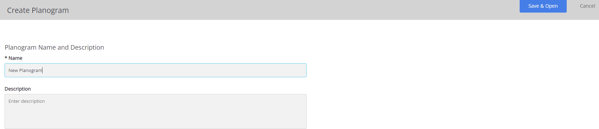
Manual Planogram Builds
Under Project Assets, select the Planograms tab
Select, Create New
On the next screen, enter in a Planogram Name, where it says Name
Select, Save & Open
See slide 33 to learn how to build your planogram which includes shelving and merchandising.
This will launch the Planogram builder!

Slide 21
Creating a New Display

Slide 22
Creating a New Display
To create a new display using an existing display template
Go to the Project Assets section of your project, select the Displays tab
Select, Create New
Tip!
You can also copy displays from other projects and then edit them.

Slide 23
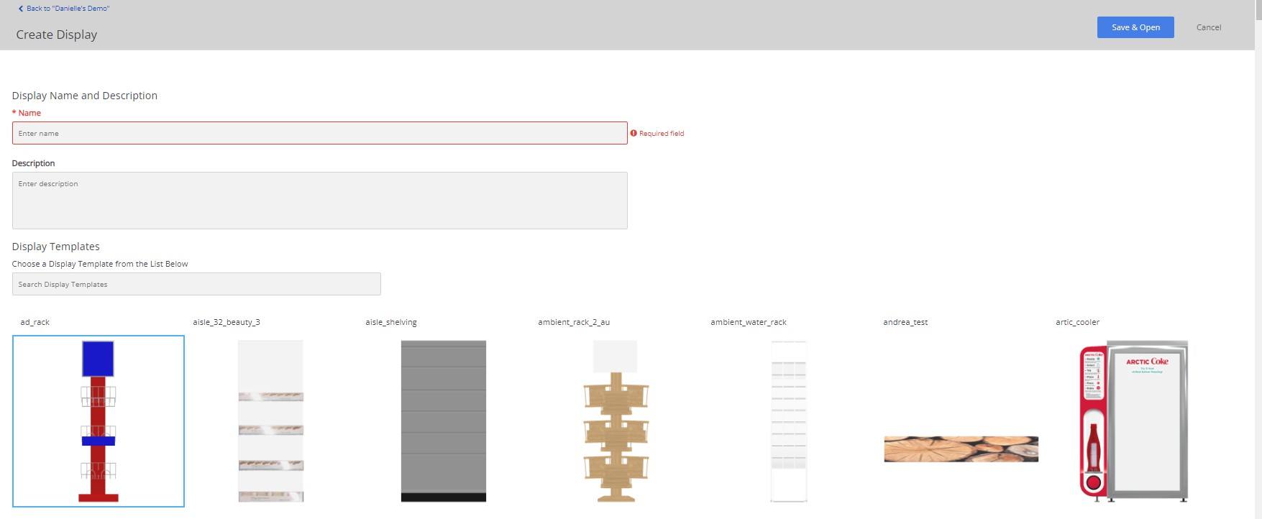
Creating a New Display
See slide 48 to learn how to add signage to a display.
On the next screen, enter the display name and pick your display template
Use the search bar if you know the template name or scroll through the display options
Select, Save & Open
This will launch the display builder!

Slide 24
Working in 3D Asset Builders

Slide 25
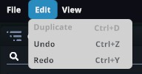
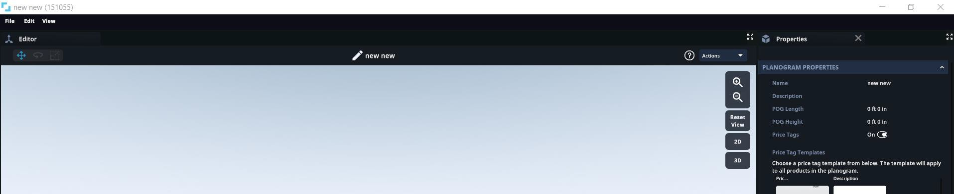
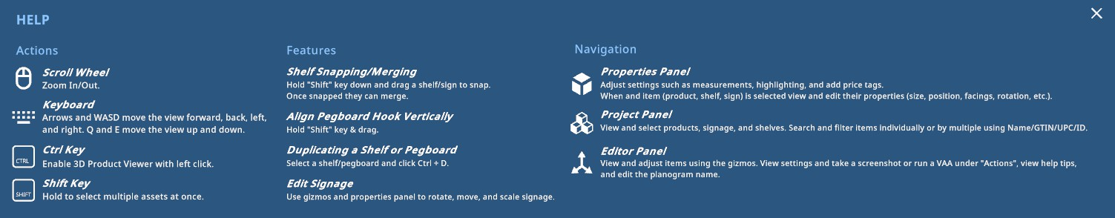
Navigation & Features
Select File to
Save and Exit
Select Edit to Duplicate, Undo, and Redo. You will also see keyboard shortcuts for the same actions.
Select the ' ? ' for instructions on Actions, Features, and Navigation.

Slide 26
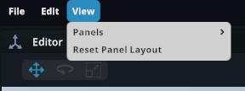
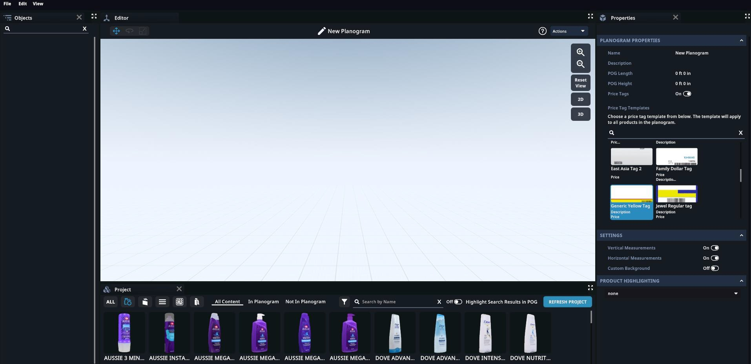
Navigation & Features | Panels
Within the POG, Display and Store builder there are four panels: Editor panel, Project panel,
Properties panel and Objects Panel.
To move the panel location, click on the panel name and drag and drop into desired space
To remove the panel from view, click the ' X ' next to the panel name.
To reset the panel's location or if you don’t see a panel, go to the top left of the screen and select View >
Reset Panel Layout
Editor
Properties
Objects
Project

Slide 27
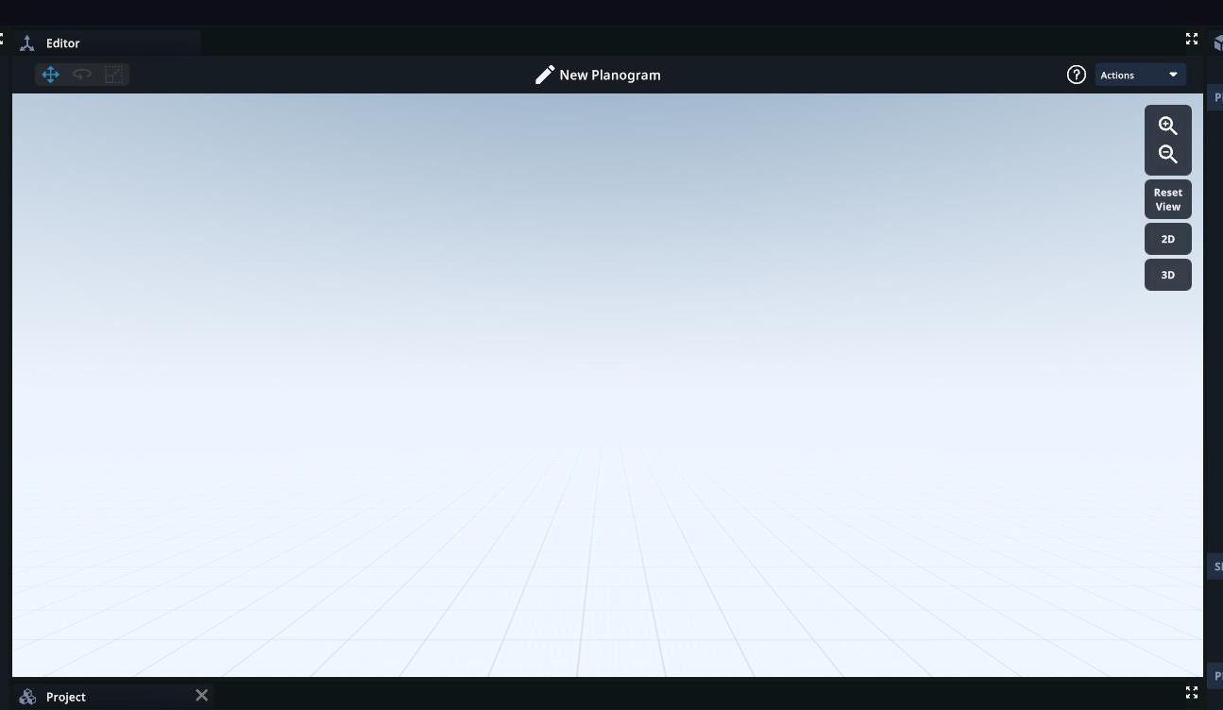
Navigation & Features | Panels
By default, the Editor panel (also referred to as the editor window) is located in the center of the screen.
This is where you will add and edit assets.

Slide 28
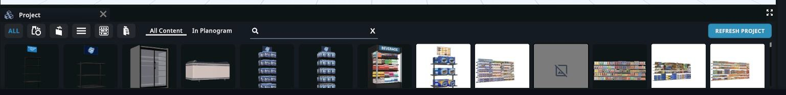
Navigation & Features | Panels
By default, the Project panel is located at the bottom of the screen
The Project panel will house all assets
Refresh Project – This will pull in any new assets that you’ve copied from another project or imported whilst the builder has been open. It saves you from having to open and close the builder.
Products
Shelves
Displays
Search by Name,
Asset ID, or GTIN
All
Signage
POGs

Slide 29
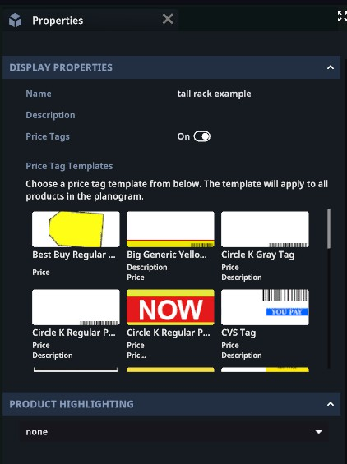
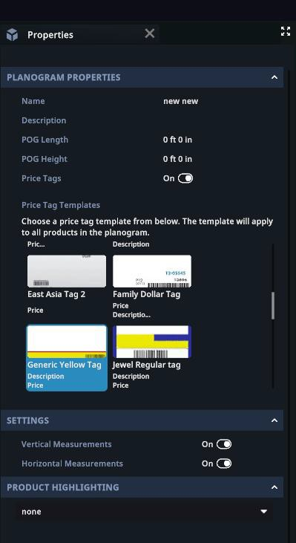
Navigation & Features | Panels
By default, the Properties panel is located at the right-hand side of the screen.
Note!
Functionality of the properties panel will change depending on what is currently selected in the builder.

Slide 30
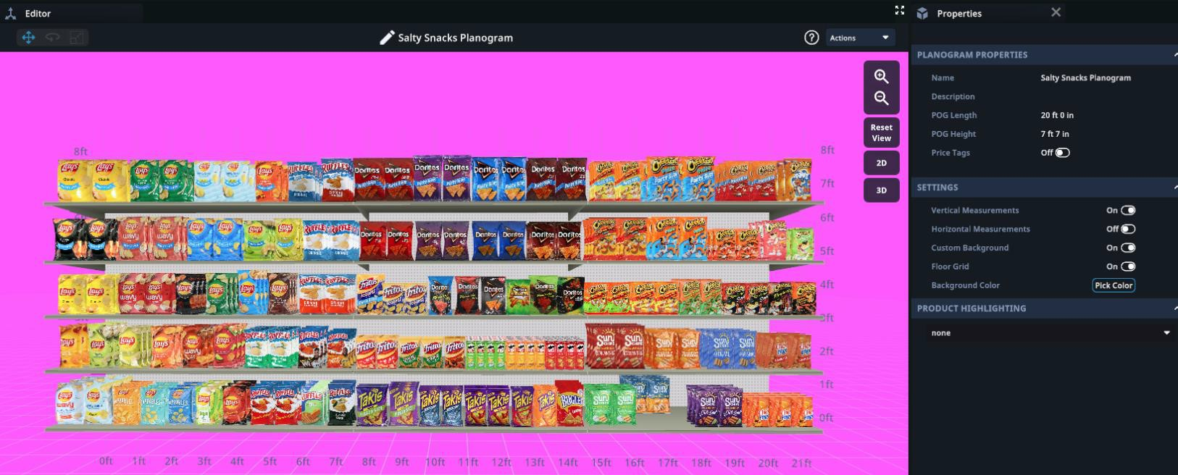
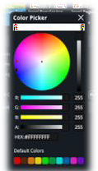
Navigation & Features | Panels
Tip!
Take a screenshot with a contrasted background to help highlight innovations/changes in your displays and planograms.
To create a contrasted background, toggle on Custom Background then select Pick Color under the Properties panel

Slide 31
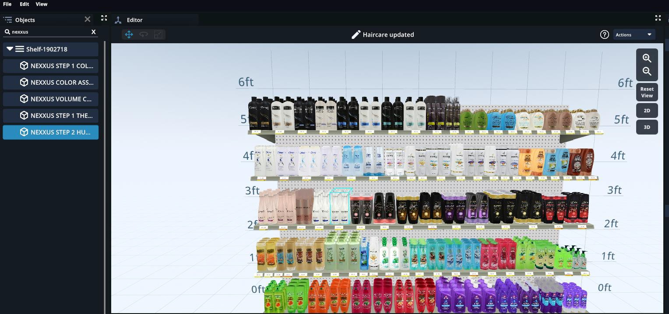
Navigation & Features | Panels
By default, the Objects panel is located at the left-hand side of the screen.
When working in display or planogram builder, you can search for products by name and select multiple products at once
In planogram builder you can also select multiple shelves at once
To search for a product in a planogram or display, type the name of the product into the search bar under the Objects panel
Click on the product in the Objects panel, you will see the product outlined in blue on the shelf.

Slide 32
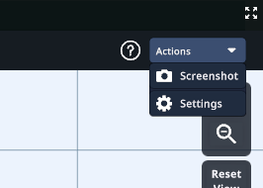
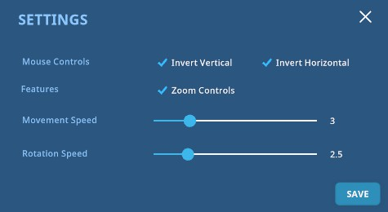
Navigation & Features | Settings
To update settings, go to Actions, at the top of the screen.
Then select, Settings
You will then be prompted to enable/disable mouse controls and features and can change
the speed of movement and rotations.
Select, Save.
Inverting the vertical and horizontal mouse controls will change the way you need to drag to look up, down, left and right.
Default Horizontal - Dragging the mouse to the left
while holding the right mouse button will rotate the view to the LEFT.
Invert Horizontal - Dragging the mouse to the left while holding the right mouse button will rotate the view to the RIGHT.

Slide 33
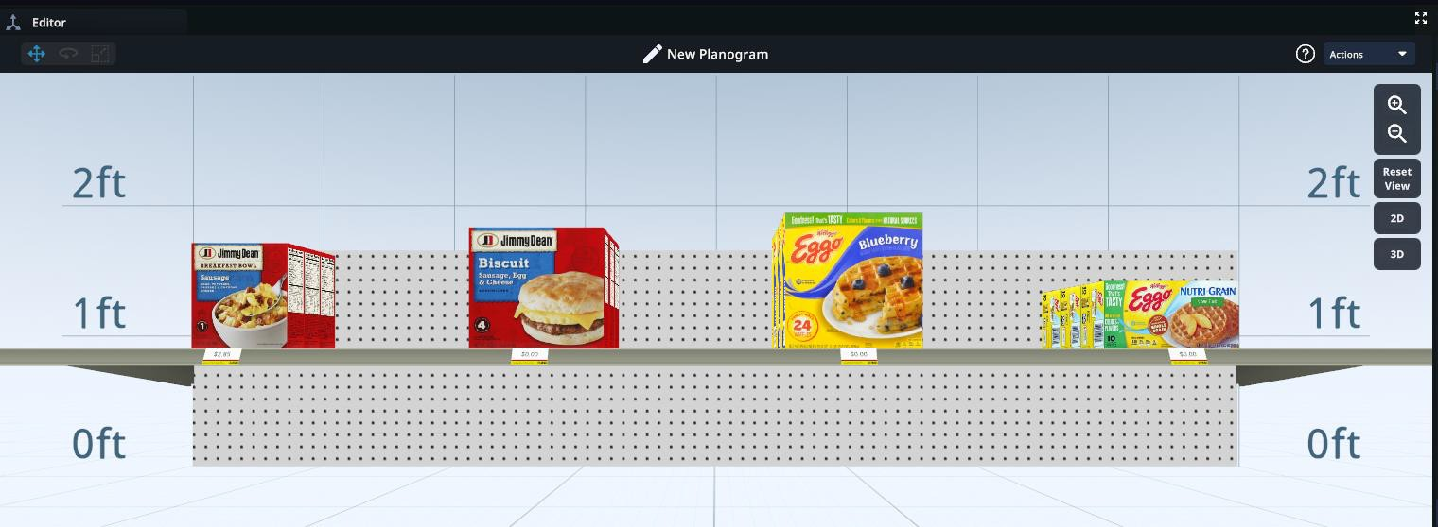
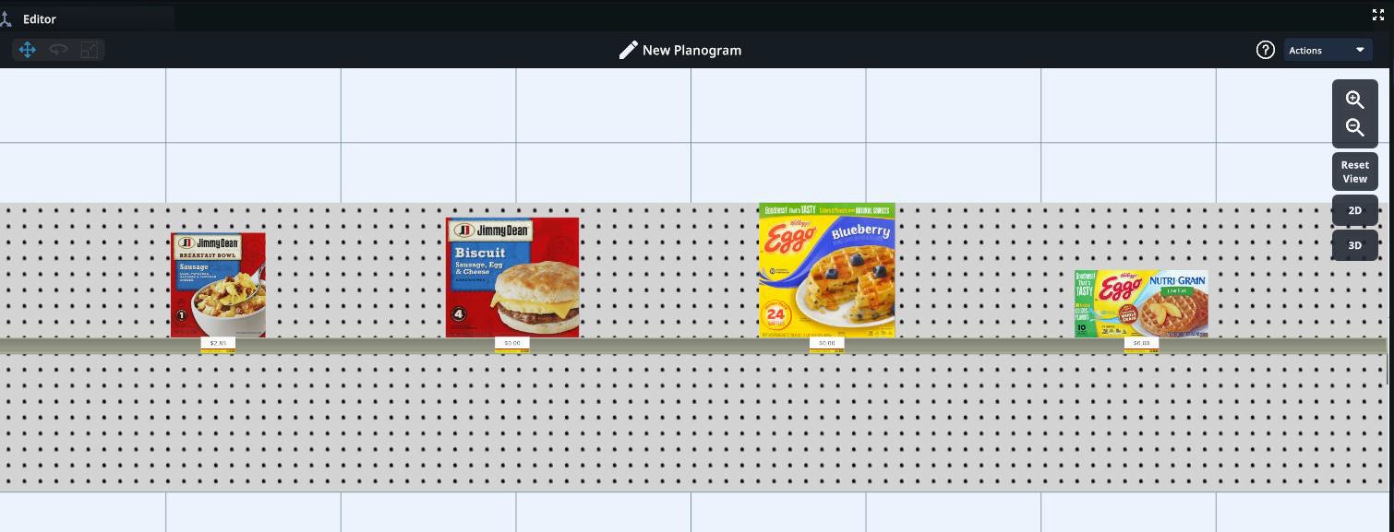
Navigation & Features | Additional Functionality
Edit Asset
Name
3D
View
Zoom in
Zoom out
Reset View
POGS
ONLY!
Switch between 3D & 2D
2D
View

Slide 34

Adding & Editing Shelves
Adding and editing shelves are unique to POG builder. Displays are fixed
structures, and their shelves cannot be adjusted.

Slide 35
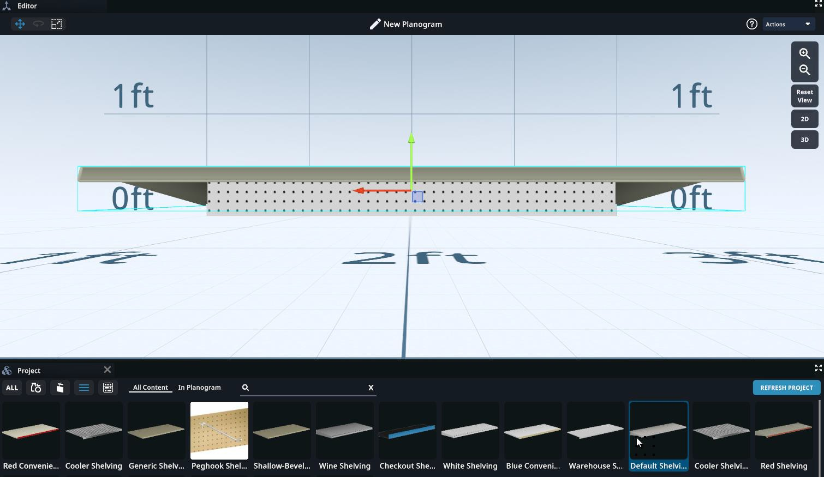
POG Builder | Adding Shelves
Under the Project panel, select the
Shelves icon
Scroll through the different shelf options and click on the desired shelf so it is highlighted blue
If you know the name of the shelf you want to use, type the name into the search bar.
Hold down the left click of your mouse and drag and drop the shelf into the center of the Planogram Builder

Slide 36
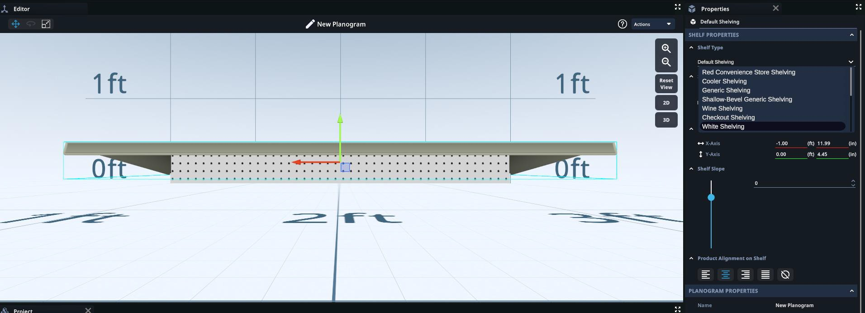
POG Builder | Editing Shelves
If you want to change the shelf type you selected to a different shelf template, click on the shelf
Under the Properties panel, on the right, select the dropdown to select a different shelf type

Slide 37
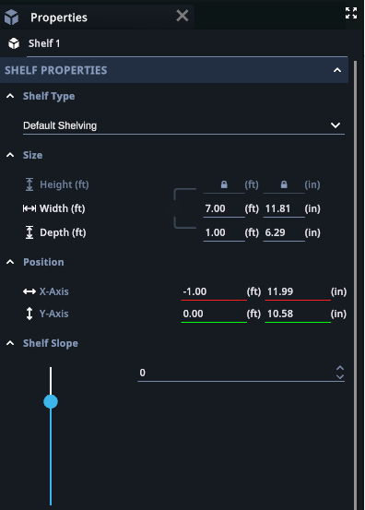
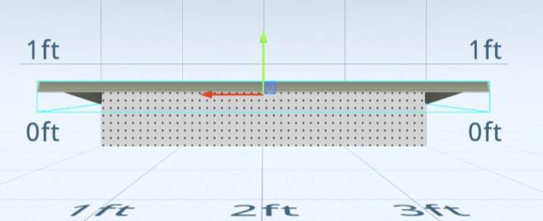
POG Builder | Editing Shelves
You can also use gizmos to adjust the x
and y axis of the shelf
Change the shelf
type
Extend or shorten the shelf width
Use the up and down arrows to adjust the shelf slope (tilt)
Extend or shorten the shelf depth
Adjust the Shelf placement left and right
Click and drag to adjust the shelf slope (tilt)
Adjust the Shelf placement up and down
To duplicate the shelf, click on the shelf, and press Ctrl + D on your keyboard
You will need to adjust the Y-Axis of the duplicated shelf
You can also do this when there is product on the shelf, it will duplicate the product(s) as well.
37

Slide 38
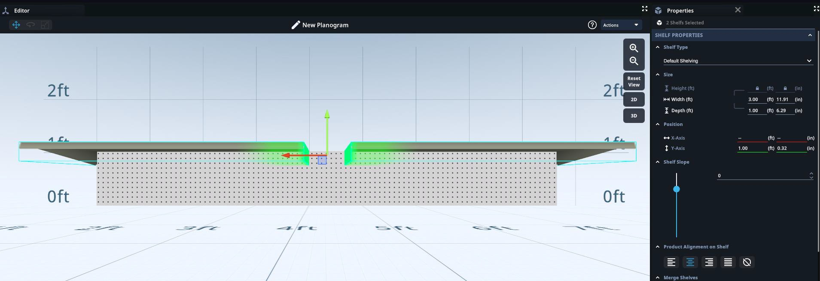
POG Builder | Editing Multiple Shelves at Once
To select multiple shelves at one time,
Click on the shelf
Hold the Shift key on your keyboard and select another shelf(s)
You will also see a list of the shelves selected under the properties panel > Selected Objects on the right.

Slide 39
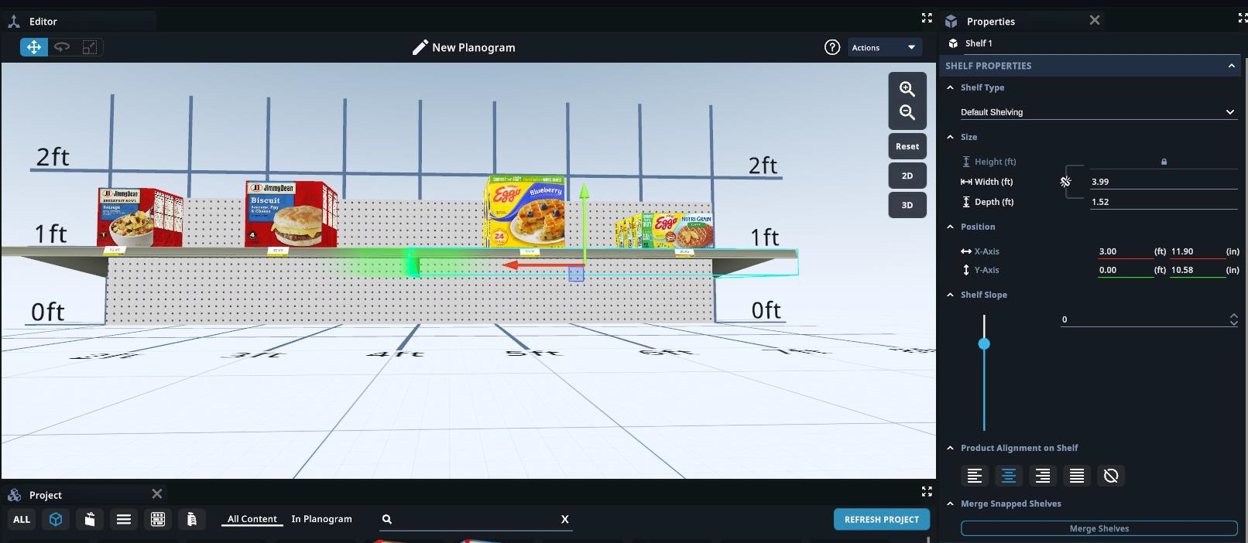
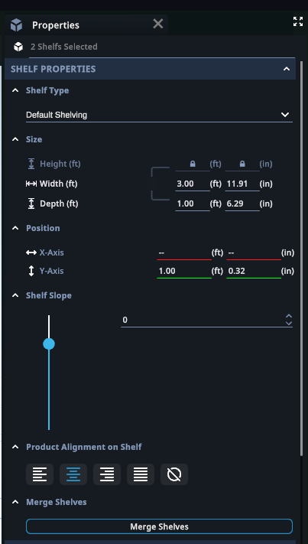
POG Builder | Merge Shelves
To merge shelves together, hold down the shift key on your keyboard. Then click on a shelf.
Hold down the shift key and click on another shelf. The ends of the shelves will both be
highlighted in green.
Then select the Merge Shelves button found under the properties panel on the right.

Slide 40
Adding Products to Shelves

Slide 41
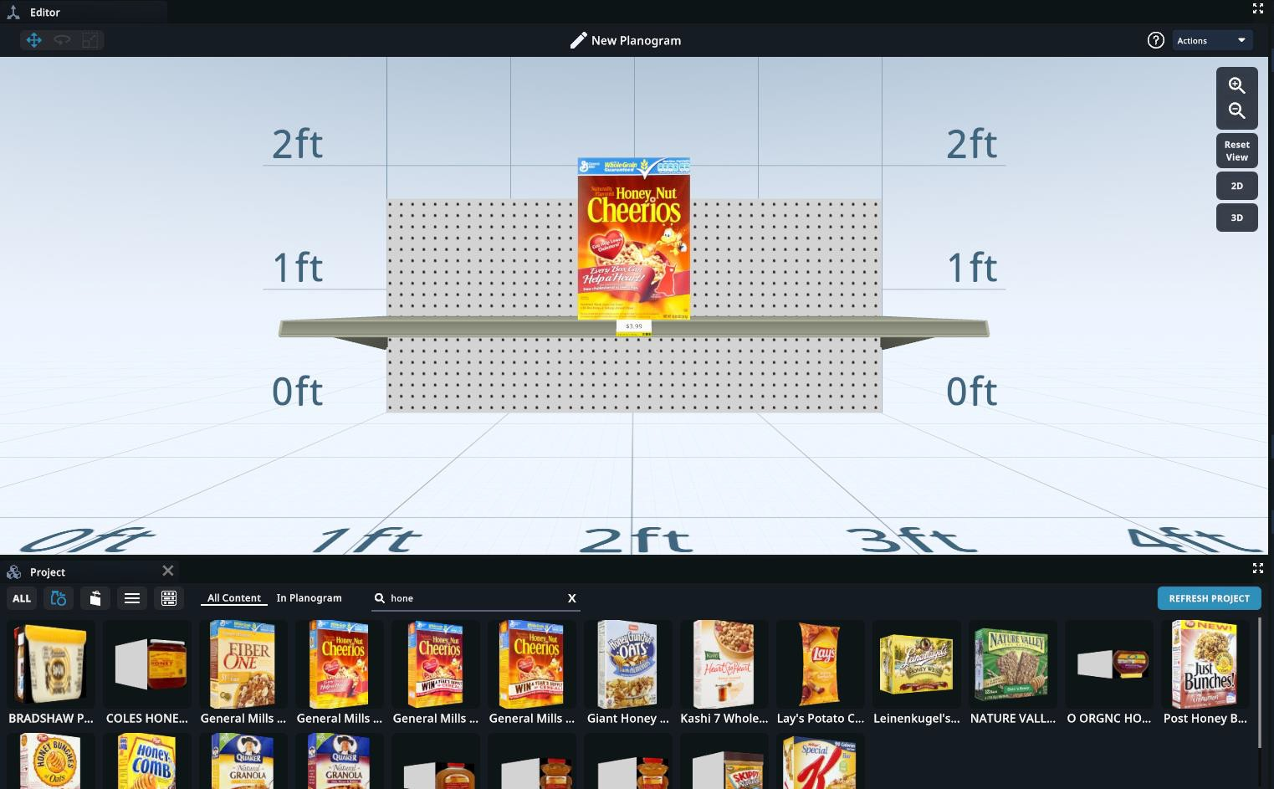
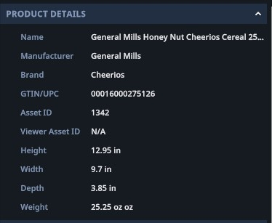
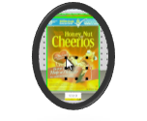
Adding Products to Shelves
Under the Project panel, select the Products icon
Scroll through products and click on the desired product so it is outlined in blue
Product details will show in the Properties panel on the right
You can also search by product name, GTIN, or Asset ID using the search bar
Drag and drop the product onto the desired shelf
Product will be highlighted green when selected

Slide 42
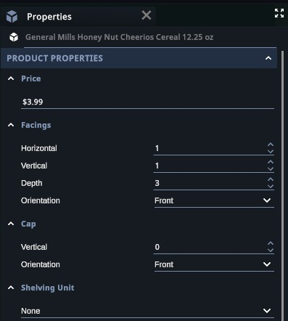
Editing Products
To adjust the product properties, click on the product and use the properties menu on the right- hand side of the screen.
Adjust the price
Adjust the number of horizontal facings
Adjust the number of vertical facings
Adjust the number of
depth facings
Add or remove cap
Change product
orientation
Use dropdown to add a shelving unit to sit on top of the shelf for products to sit in
Change orientation of
cap ONLY
42

Slide 43

Editing Multiple Products at Once
To select multiple products at one time
Click on the product so it is outlined in blue
Hold the shift key on your keyboard and select another product(s)
You will also see a list of the products selected under the properties panel on the left

Slide 44

Product Alignment
To adjust the alignment of product(s) on the shelf, click on the shelf
Under Shelf Properties, look to the Product Alignment on Shelf section.
Left
Center
Right
Justify
No Alignment – Allows you to freely move products on shelf.

Slide 45



Asset Builder Properties
Under Properties you will see a toggle for price tags.
This will allow you to turn price tags on and off
You can change the price tag template by scrolling
through and clicking on the desired template
Measurement Settings are unique to POG builder!
Under Planogram Properties > Settings you can turn the vertical and horizontal measurements on and off by using the toggles
Tip!
Hovering over a price tag will enlarge the preview.

Slide 46

Asset Builder Properties
When you select a product, you will see a lot of its metadata in the properties panel. From here, you can also select Snap to Front/Back of Shelf.
As you can see from the image, selecting a product to sit at the back of the shelf will set the product slightly further back.
When you add or delete the number of depth facings, this will adjust how far back the
product sits on shelf. You can also adjust the depth of the shelf to adjust how far back the product sits.

Slide 47

Product Viewer | Pick up from Planogram or
Display
To get a 3D view of a product, view it
in the product viewer.
Select the desired product within the POG or display holding down Ctrl and clicking on the product.
Within the product viewer, you can rotate, twist, and zoom in and out on the product.
The viewer window can be moved around and will allow you to continue working on your POG or display. Click and hold the black bar at the top, to do so.
Selecting another product will replace
what is in the viewer.
Exit product viewer
Move
Twist
Rotate
Zoom
in
Zoom
out
Reset
View
Product Details

Slide 48

Product Viewer | Pick up from the Project Panel
Double click on any product from the Project panel to see it in the product viewer.
Picking up from the project panel will only show a 2D view of the product

Slide 49
Add Signage to POGs & Displays

Slide 50

Adding Signage
Under the Project panel, select the Signage icon
Scroll through the different sign
options and click on the desired sign so it
is highlighted blue
If you know the name of the sign you can
search by name in the search bar
To create a new sign, select the Upload button located on the right side of the Project panel
Accepted file types include .png & .jpg
New signs will appear in the Project panel
See next slide for another way to create a sign
Drag and drop the sign from the project panel into the asset builder's editor window

Slide 51


Create a Sign from the Project Page
On the Project page in ShopperMX go to Project Assets
Signage
Click Create New.
Enter the Name and Description.
Click Upload Image Files.
Choose your Template. Scroll down the screen to select the template that best fits the dimensions of your image.
Click Next-Design Sign. ShopperMX Sign Builder will open.
Click on the image and drag it onto the template. Scale, Rotate, Mirror or Clear the image to start over. When complete, click Preview.
Click Save to finalize your signage or Back to Editor
to make changes.
Tip! Good option if working with a double-sided sign that has different images on either side.

Slide 52

Editing Signage – Option 1
Use the different gizmos at the top left of the editor window to edit signage.
Movement Gizmos will allow you to move signage
Red = left and right
Blue = forward and back
Green = up and down

Slide 53


Editing Signage – Option 1
Rotation Gizmo will allow you to rotate or spin signage. Use the different colored gizmos to change the orientation of the signage.

Slide 54



Editing Signage – Option 1
Tip!
To resize just the width or just the height you will need to click on the link to "break the link"
Resize Gizmo will allow you to make the size larger and smaller
Click and hold either gizmo and pull out to make a sign larger
Click and hold either gizmo and push in to make sign smaller
Linked
Broken Link

Slide 55

Editing Signage – Option 2
Use Sign Properties, on the right, to edit signage. Make sure you click on the sign first!
Rotate or spin the sign by typing in a number in each section. The dials will change color.
Resize the sign. If you want to adjust just the width or just the height, ensure to "break the link"
Set a new default size. This will affect new signs only. ONLY true if you use the same sign as before.
Adjust the position location of the sign X = right & left
Y = up & down
Z = forward & back
55

Slide 56

Export Planogram Edits to .PSA
Save changes to your planogram in the asset builder.
Go back to the project page > Project Assets >
Planograms
Click on the dropdown menu next to your planogram
Select Export as .psa
This functionality is unique to Planograms!

Slide 57
Products

Slide 58
ShopperMX Assets - Products
There are 3 options to create products in ShopperMX:
Getting products into ShopperMX:
Autowrap – ShopperMX feature (DIY)
What is it: ability to upload images and wrap those images on one of our 7 shape offerings (box, bag, can, bottle, six pack, other, or 2D)
When to use it: if you have access to an image provider
Advantages: user is in control, 1-2 day turn-around
Caution: Image provider may not have all 6 sides, high resolution or haven’t
properly cropped out the white space which may result all result lower quality
Import products via a .PSA file
Import bulk number of products with metadata (SPL) & images - Autowrap
Custom Model – ICS Service (fee
associated)
Create products individually with product metadata & images - Autowrap
What is it: full service product modeling (acquisition, photography & 3D
modeling)
When to use it: if you don’t have access to photography
Advantages: high quality, quick turn-around, full service
Import 3D models – requires ICS assistance. Contact ICS for more information!
SnapShelf 3D – Coming Soon!
What is it: Take a picture of an in-store planograms through SMX GO, to pull in
products to ShopperMX
When to use it: if you don’t have access to space planning
Advantages: create a control planogram of what is in store today
Import picture of in-store planograms

Slide 59

What Makes our Clients Successful: Master Libraries
What is a Master Library?
A Master Library is a central source of high-quality product images & data. Allows you to fast-track projects by accessing products that were previously created.
How can you build your Master Library?
Identify categories & products from top projects
Work with your image provider to pull high quality images
Create a new project in ShopperMX and name it as "Master Library"
Import planogram & link .psa file UPCs to image files for auto wrap
Continue to build categories as you execute more ShopperMX projects
When a Master Library is ready, inform your ICS account rep. You will then see an orange label on the project, and the products within.
59

Slide 60
How to access existing products in ShopperMX
ShopperMX will link the UPCs in your .psa file to the
Master Library
Pro: Streamline process
Con: you need to make sure you .psa file has accurate data
Import Planogram File
In ShopperMX, go to Project Assets > Planograms > Import
Drag and drop .psa into the box on the screen
Full instructions found under Import Planogram section (slide 12)
Copy all products into your project
Pro: you have access to all products with Master Library Setback: you may not want so many products in your project
Copy From…
In ShopperMX, Go to Project Assets > Products > Copy from ...

Slide 61



Create New Autowrapped Products in SMX | Individually
On the project page, go to Project Assets > Products > Click Create New
Click the Upload button above a box to upload an image of each applicable facing of the product.
When ready click Save Product at the top right of the screen
Fill in required product information Name, GTIN/UPC, Shape, Dimensions
General guidelines for creating individual products!
Creating less than 10 products
More flexibility with image naming guidelines

Slide 62
Create New Autowrapped Products in SMX | In Bulk
General guidelines for creating products in bulk!
Creating 10 or more products
Must follow exact image naming guidelines
Best for 2D, 2.5D, & 3D box-shaped products
Two-step process
Step 1- Import .psa or product data
Step 2– Import images
Pro tips!
Break up the upload in batches, to import images faster
If possible, update your .psa file UPCs versus renaming all your image files when there is a miss-match.
When renaming image files, Bulk Rename Utility is a great 3rd party software
If Image providers uses .tga file types you must either zip the files or add the extension.
When working with several private label products, create a separate Master Product Library specific to your retailer or region
Inputs required:
Product information: .psa file data or SMX product data
Product image files in correct naming convention (see slide 65)

Slide 63

Create New Autowrapped Products in SMX | In Bulk
Step 1 – Import .psa or product data
Option 1 – Import a .psa file. See importing a .psa on slide 12.
Option 2 – Import product data
In ShopperMX, go to your project > Project Assets > Products > Import
- Download the product template

Slide 64

Create New Autowrapped Products in SMX | In Bulk
Step 1 – Import .psa or product data
Open the template and fill in the required fields: GTIN or Product ID, Product Name, Dimensions, & Shape
If you have more product data, fill it in before uploading! (i.e.. Brand, Category, manufacturer, price, custom fields)
o Save template to computer, then drag and drop file into the designated box to upload.

Slide 65


Renaming Product Files in Bulk (Advanced)
This is a way to rename your products in bulk before you upload them into ShopperMX. You may want to do this if the product images, do not follow the naming conventions specified by ShopperMX. Please refer to slide 65 to see these naming conventions.
Search for ‘PowerToys’ within your search bar at the bottom of your desktop. If you cannot find PowerToys, you will need to download it from the Microsoft Store by following this link - https://apps.microsoft.com/detail/XP89DCGQ3K6VLD?hl=en-GB&gl=GB&ocid=pdpshare
When PowerToys has opened, scroll down to PowerRename and toggle on ‘Enable PowerRename’. You can
now close the application.
Now open file explorer and select all the product names you would like to change.
Right click and then select PowerRename. A window like the one below should open.
You can then use this tool as a find and replace tool to add file extensions or to change the name inline with the naming convention. You can make change to the file name, extension or both.

Slide 66


Create New Autowrapped Products in SMX | In Bulk
Step 2 – Import image files
Go back to project, then Project Assets > Products > Import Product Images
Remember! Product image files MUST have the correct naming convention for image importing to work.
Make sure that the images you are importing have the exact same number of digits as the GTIN/UPC of the product you are trying to upload to. i.e. 14 digits for 14 digit GTIN’s/UPC’s.

Slide 67


Create New Autowrapped Products in SMX | In Bulk
Step 2 – Import image files
On the next screen, drag and drop image files into the box to bulk upload.
You can also upload individual sides for images

Slide 68
Planogram Image Refresh
Refresh the products on your planogram after it has been created.

Slide 69


Planogram Image Refresh | Workflow 1
Ask us about Synidgo & Omnipix APIs!
Replace products in your planogram that have missing images, with the newly created products.
Once you have created or added new products on your project click on the arrow under the planogram.
Select the Refresh Products.
Click on Refresh Products with Missing Images workflow.
Any product GTIN that is an exact match will automatically be replaced. Any that are not, will go through the quick match process.
Select the product that you would like to replace.
Once you have selected all the matches, click Save Planograms

Slide 70

Planogram Image Refresh | Workflow 2
Ask us about Synidgo & Omnipix APIs!
Replace Outdated Products with New Products.
Determine which products in your planogram are outdated.
Once you have created new versions of the outdated products and added them to your project, click on the arrow next to the Planogram.
Select the Refresh Products
Click on Refresh Products with Updated Images workflow.
You will be asked to go through the quick match process to select the products/s you would like to replace in your Planogram.
Once you have selected all the matches, click Save Planograms.

Slide 71
Store Building & Editing
Creating a Store Navigating a Store Adding Assets to a Store
Adding & Editing Signage in a Store Moving Assets
Rotating Assets
Switching between Asset Builders

Slide 72



Creating a Store
On the project page go to Project Assets > Store Concepts
Click on Create New.
Type your store name and description (if applicable .
Select the store template by clicking on the store
or searching for the store concept with the search
bar. Click Save & Open.
To reuse a previously built store,
Go to Project Assets > Store Concepts
Click Copy from...
On the next screen select the desired store and select Copy in the top right corner.
Please note, that all assets and content that is housed in the original store will also be
copied into your project.

Slide 73







Navigating a Store
40
Double click anywhere in the store to drop to that section, use your mouse to scroll forward, or use the navigation options.

Slide 74


Navigating a Store
File – Save (Ctrl + S) and Close (Ctrl + Q)
Edit – Undo (Ctrl + Z), Redo (Ctrl +Y), and Duplicate assets (Ctrl + D)
Record a video
Take a screenshot
Settings – adjust your height or movement speed
View – View panels and adjust layout
Home or
Ariel view
Fly or walk
navigation
Gizmos Scaling, moving or rotating assets
Tour Builder
Enter VR (only works with a headset)

Slide 75

Store Builder Navigation | Object Panel
The panel layout is the same for Store builder as it is for Planogram and Display builder. (See slide 25 for a refresh).
The Objects panel has different functionality in store builder.
Here you will see all objects and fixtures that are included within the store in a list view. Assets will appear here as they are added to the store.
Objects are organized in a folder system within the store.
Search: Search for object or asset by name. To jump to the object or asset, click on the item and then select the 'F' key on the keyboard.
Visibility: Click to hide
and unhide an
object or folder
from view
Lock: Allows for object or folder to be toggled to a locked or unlocked state
Create folder: Create folders to group objects together. Great way to visualize different scenarios in the same store!
Delete: Delete object or folders
Note!
When an object is deleted from a store and saved, it cannot be brought back. Best practice is to move the fixture to a different area of the store or to hide the fixture. This does not include assets.

Slide 76

Store Builder Navigation | Project Panel
Project Properties
This is a panel where the user can access all the 3D asset types / content that can be added to a store
Displays
Signage
Tools
Planograms
Stores
Pinboards

Slide 77


Store Builder Navigation | Properties Panel
Rename your object by clicking in the name bar and typing
Make your aisle HD by clicking this button
Edit aisle length here. Lengthening aisles or coolers allows you to fit any sized POG in any virtual environment
When selecting your POG, you can highlight your products based on certain categories (update this in your product metadata in ShopperMX.com)

Slide 78


Adding Assets to a Store
Step 1
In the Project Panel, choose Planogram, Display or Signage.
Step 2
Click and drag the POG, Display or Sign you wish to place into the store.
For planograms, make sure you see green highlighting to ensure it has snapped to the shelf.

Slide 79

Adding & Editing Signage in a Store
To upload new signage to the store, follow the same steps as you would in the other asset builders. Refer to slide 49.
Signs can also be adjusted in store. For full details refer to slides 51 – 54.
Tip!
Signs can be placed on the floor to make floor stickers or
perpendicular to make aisle flags.

Slide 80





Moving Assets
In the editor panel, you will see three icons referred to as gizmos:
To adjust the positioning of an object, select the object and then select the 3 arrows will appear and you can click and drag on each arrow to adjust as necessary.
X/Y/Z - Plane Scale Signage
button.
Adjustment
Tip!
You can also move in-store aisles and fixtures.
Red arrow= left and right
Blue arrow = forward and back
Move your objects along the x-axis, y-
axis, and z-axis.
Make your items bigger. For signage ONLY!
Green arrow = up and down

Slide 81




Rotating Assets
To rotate an object select this button:
. Click and drag to the circle in the direction you whish to rotate the object.
Rotation Panel X-
Rotation Panel Y-
Axis
Axis
Tip!
You can also rotate in-store aisles and fixtures.
Rotate your objects around on the x- axis, .
Rotate your objects around on the y- axis. For signage ONLY!

Slide 82
Switching Between 3D Asset Builders

Slide 83


Switching Between 3D Asset Builders | Stores
Once you have placed a Planogram or Display in a store, you can toggle between asset builders without exiting the application.
Right click on the planogram or
display under Objects
and select Edit
Planogram or Edit
Display
OR
Right click on the planogram or display in the project panel and select Edit Planogram
or Edit Display

Slide 84

Switching Between 3D Asset Builders | Toggle between different Planograms and Displays
Under the Project panel at the bottom of the screen select the planogram or display icon
Select the planogram/display you’d like to switch to by using the right click of your mouse
It will be outlined in blue
Select Edit Display
You will then be prompted to save what you are currently working on
A loading bar will then appear for the display that was selected

Slide 85

Switching Between Builders | POG or Display Builder to Store Builder
Once you have finished editing your planogram or display, switch back to
store builder, by going to File, then Exit to Store

Slide 86
Presentation Tools
Product Highlighting
Taking Screenshots & VAA Reporting
Creating a DIY Video
Tours Pinboards

Slide 87
Product Highlighting
Highlighting is an excellent way to showcase recommendations like segments, brands, pack types, price tiers, and more!

Slide 88



Product Highlighting Output
Store Builder
POG Builder
Display Builder

Slide 89


Product Highlighting
Note!
You can do this in the Store Builder, POG Builder or the Display Builder.
Under the Properties panel > Product Highlighting
You can highlight products based on the products' metadata
Go to the dropdown and click on the metadata field you'd like to highlight so the checkmark is blue
Click on the colored boxes to change the color. Use the slider or type in a number for each of the RGBA fields

Slide 90



Creating or Editing Highlighting
Step 1 – Click ‘Download Products’ under Product tab in project page.
Tip!
You can edit the Custom Data columns to capture more data. Simply replace the heading for a given column and add in the data for each product.
Examples include, Package Type,
Flavor, Segment, etc.
Step 2 – Edit product data or add columns you would like to highlight, save import .xlsx
Step 3 – Select Import under Products tab. Select file saved in step 2.
Highlights will be updated once import is complete.

Slide 91
Taking Screenshots & VAA Reporting

Slide 92


Taking Screenshots
Note: Your screenshot will automatically be saved to your Media Collection.
To take a screenshot, go to the top of the screen and select Actions > Screenshots
You can then select the resolution in which to take the picture
Once the picture is taken you will be prompted to save the picture to your device
Click to generate VAA report before taking screenshot. See slide 89 to learn more about VAA
Tip!
Within the POG builder, when you go to take a screenshot, you can tick ‘Transparent Background’ for your screenshot to have no background.

Slide 93




VAA Reporting
Visual Attention Analysis (VAA) is a report which uses science-based algorithms to analyze your visuals i.e. planograms, in seconds. It helps you make sure that the content you want to be seen, will be seen.
If you selected the Analyze button before taking a screenshot a VAA report will be generated
When the VAA report is ready you will receive an email
Download the report at your convenience
Examples of what’s included in the VAA report-
Heatmap
Hotspots
Gaze Sequence

Slide 94
Creating a DIY Video

Slide 95



Creating a DIY Video
On the right-hand side of the screen, click Actions >
Video
When ready, click on the Record Editor Window
button.
You can film up to 2 minutes of video footage at a time.
You will know the recording has started when the timer starts.
Click Stop Recording Editor Window when done.
You can Play back the video, Save it or create a New Video.
Note: Your video will automatically be saved to your Media Collection.
When recording is ready you will receive an email to your inbox!

Slide 96

Creating a DIY 360 Video
You can make a quick 360 display video!
Start by clicking on a display or fixture.
Click Actions > Video
Adjust camera angle and zoom to where
you want the video to be taken.
Select 360
ShopperMX will take a 360-degree video of the display you’ve chosen, save when completed.
Note!
Does not work for end caps.

Slide 97
Tours
Create The ability to set a pre-defined route in the store environment to do a live hands-free walk through or a hands-free video recording. This makes it easier to navigate around the store and stop at the exact spot you would like with easy.

Slide 98




Setting up a Tour
Step 1 – Click on the Tours button in the Editor Panel.
Step 2 – Click on the screen where you would like the position of the video to start. You will notice your mouse has changed to a bullseye. Select the next action point and so on to create your route. Do not worry about the direction of the arrows just yet.
Step 3 – When you want the route to end, hit the ‘esc’ button on your keyboard. Alternatively, you
can unclick the Tours button in the editor panel.
Tip!
When adding Action Points, it is easier to get a higher view so fly above the area where you want to set up the Tour.

Slide 99




Adjusting a Tour
Step 1 – Select 'Action Point' from within the Objects panel.
Step 2 – Using the rotate and move tool within the editor panel, adjust the positioning of the action point just as you would with other objects in the store environment. You can see the view of the Action Point in the properties panel.
Tip! The Action Points height are automatically set at your eye level. If you want to adjust their height, click an Action Point in the Objects panel, select the move gizmo, then use the green arrow to move the action point up or down.
To delete an Action Point, click on that action point either in the Objects panel or within the store. Then press delete on your keyboard.

Slide 100



Extending the Tour
To add an Action Point to the end of your path,
Click on 'Tour' in the Object Panel then click the Tour Builder button in the editor panel.
To Add an Action Point to the middle of your path,
Click on an Action Point from the objects panel
Next, select the Tours icon
Hover your mouse over along the green dots so that the path turns yellow. Click on the path where you want to place the Action point.
Click where you would like the new action point.
Once you have finished, press Esc on your keyboard
Once you have finished, press Esc on your keyboard.

Slide 101


Playing a Tour
Step 1 – Click 'Tour' in the Objects panel
Step 2 – A set of controls will pop up in the Editor Panel on the right-hand side.
Play from the Beginning
Play
Stop
Move to the Previous Action Point
Move to the Next Action Point
Step 3 - Once the Tours has played all the way through, click Okay to exit the Tour.

Slide 102



Recording a Tour
Step 1 - Select 'Tour' in the Object Panel.
Step 2 - In the Editor Panel, click on Actions then Video.
Step 3 – Click on Record Tour. You can preview and save the video just like any other video you take in the store environment. It will also save to your Media Collection.

Slide 103



Additional Tour Settings
Adjust the speed and pause duration of the entire Tour
To adjust the speed - In the Properties Panel, drag the dot along the bar next to it go faster or slower.
To adjust the pause duration – In the Properties Panel, drag the dot along the bar to add a pause to all action points.
To add/change pause duration at each Action Point
Step 1 - Click on the Action Point in the Properties Panel then click the three dots. Then click Settings.
Step 2 – Click “Override Global Pause Duration” then drag the dot along the bar to set how long you want the Tour to
be pause at just this action point. You can fully stop at that Action Point by clicking the checkmark.
If you choose to stop at the Action Point, you will have to click play again to continue through the rest of the Tour.

Slide 104

Additional Tour Settings
Toggle Content in the Object Panel On and Off
Can be used on any Action Point that you added a “Stop on Point”.
When the Tour has stopped at that Action Point, the Object Panel will pop up. You can then toggle the visibility on and
off for any content in the Object Panel.
Example: Have two different Planograms/Displays/Signs (current vs. idea/future) you want to showcase in your video.
Toggle between these two Planograms
Object Panel Popped up

Slide 105
Pinboards
Your digital whiteboard that enables you to upload PDFs, PowerPoints and videos into your Store / Environment.
There are 4 steps to getting in a pinboard in store:
Adding Media to Media Library
Creating a Pinboard
Placing a Pinboard in Store
Adjusting a Pinboards’ Settings

Slide 106


Adding Media (PPT’s, Videos or PDF’s) to your Media Library
Step 1 – On your shoppermx.com webpage, click on your project and scroll down to Media Collection.
Step 2 – Click on either User Videos, photos or documents, depending on what media you would like to upload. Then click on the blue ‘Upload’ button, followed, by ‘Select’. Please read the specification to ensure you are uploading the right type of file.
Step 3 – Select the media you want to add (you can select multiple at a time by holding
down ctrl), then click ‘Open’.
Step 4 – The system will process the media you selected, and a green bar will appear when its successful. Feel free to now close this pop-up
Videos and photos that have been taken using the record or screenshot button within SMX will automatically appear in your media library.

Slide 107



Creating a Pinboard
Step 1 – Open a store. Under Projects Panel in the Store Concept, click on the Pinboard’s
icon.
Step 2 - Click ‘Create’.
Step 3 – Name your Pinboard then click Save.
Step 4 – Select the media you would like to include in the pinboard. Make sure that you
click through all the different filters to see your media options. Then click ‘SELECT’.

Slide 108


Placing a Pinboard in a Store
Step 1 – Under Projects in the Store Concept, click on the Pinboard’s icon.
Step 2 – Click and drag the Pinboard you wish to place and drag it into the store.
Step 3 – Using the buttons at the top of the editor button you can move, rotate and resize the pinboard as you wish, just like you would with signage.
Step 4 – Select the media from within the pinboard and then click on the full screen button.

Slide 109


Adjusting a Pinboard Settings under Properties Panel
Surface Attachment
Adjust the way the pinboard attaches to a surface. (Can always use the movement or rotation gizmos to adjust pinboard once placed in store)
Pinboard
Add Pin – add additional media to create a new pin to an already existing pinboard.
Pin Setting – Rename, Replace with different media, Sizing Settings, and Delete

Slide 110


THANK YOU!
ADD CS/PS Contact info Name, title, email
110

Slide 111
ShopperMX Support Resources
Need a refresher or have a specific question on
SMX functionality?
Check out ShopperMX Support for a library of help content and articles. You can also click the Support button from the home screen.
111

